Slide 1

Exam Hall Seating Arrangement
This project aims to automate the process of assigning seats to students for examinations, minimizing manual effort and potential errors.
UNDER THE GUIDANCE OF
Dr.R. UMAMAHESWARI
J. JEFFRIN SANJITH
A.K. KARTHICK RAJA

Slide 2

Project Objective
1
Reduce Manual Work
2
Efficient Seat Allocation
The system eliminates the need for manual seat allocation, saving time and effort for administrators.
It ensures a streamlined and organized approach to assigning exam seats, optimizing resource utilization.
3
Student Convenience
Students can easily locate their assigned exam halls and seats, reducing confusion and stress on exam day.

Slide 3
Technologies Used
Front-End
Back-End & Database
HTML (Version 5)
Hypertext Preprocessor (PHP Version 8.2)
CSS (Version 3)
MySQL (Version 10.4.32-MariaDB)
Bootstrap (Version 3)
JavaScript (JS Version E6)

Slide 4

Project Description
Class Module
Student Module
Administrators can manage class details such as year, department, and division. This module facilitates the creation of new class entries and provides an overview of existing ones.
This module enables administrators to add, view, and manage student information, including names, roll numbers, classes, and login credentials.
Room Module
Administrators can use this module to add, view, and delete room details, including room numbers, floor locations, and seating capacities.

Slide 5

Project Description
Allotment Module
View Allotment Module
Dashboard Module
This module facilitates the allocation of students to specific exam rooms based on criteria such as class, room capacity, and roll number ranges.
Administrators can utilize this module to view the seating arrangement for each exam room, ensuring efficient allocation and oversight.
Students can access this module to view their assigned exam room, floor, and seat number \
providing transparency and convenience.

Slide 6
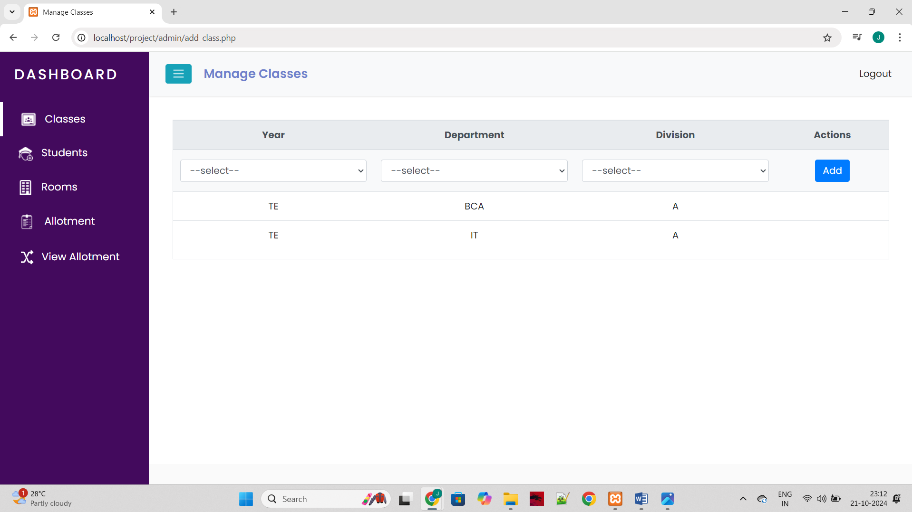
SCREENSHOTS

Slide 7
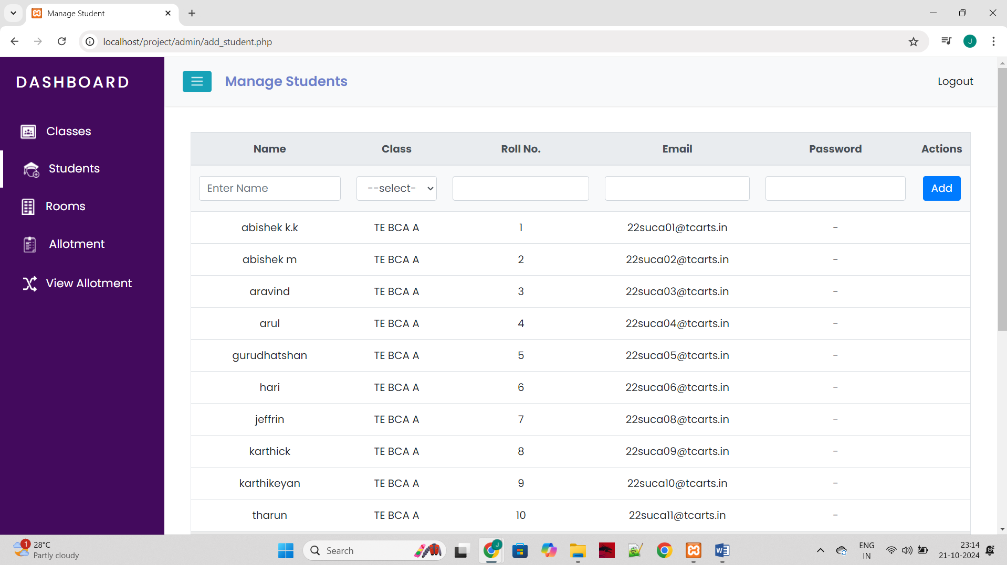
SCREENSHOTS

Slide 8

SCREENSHOTS

Slide 9

SCREENSHOTS

Slide 10
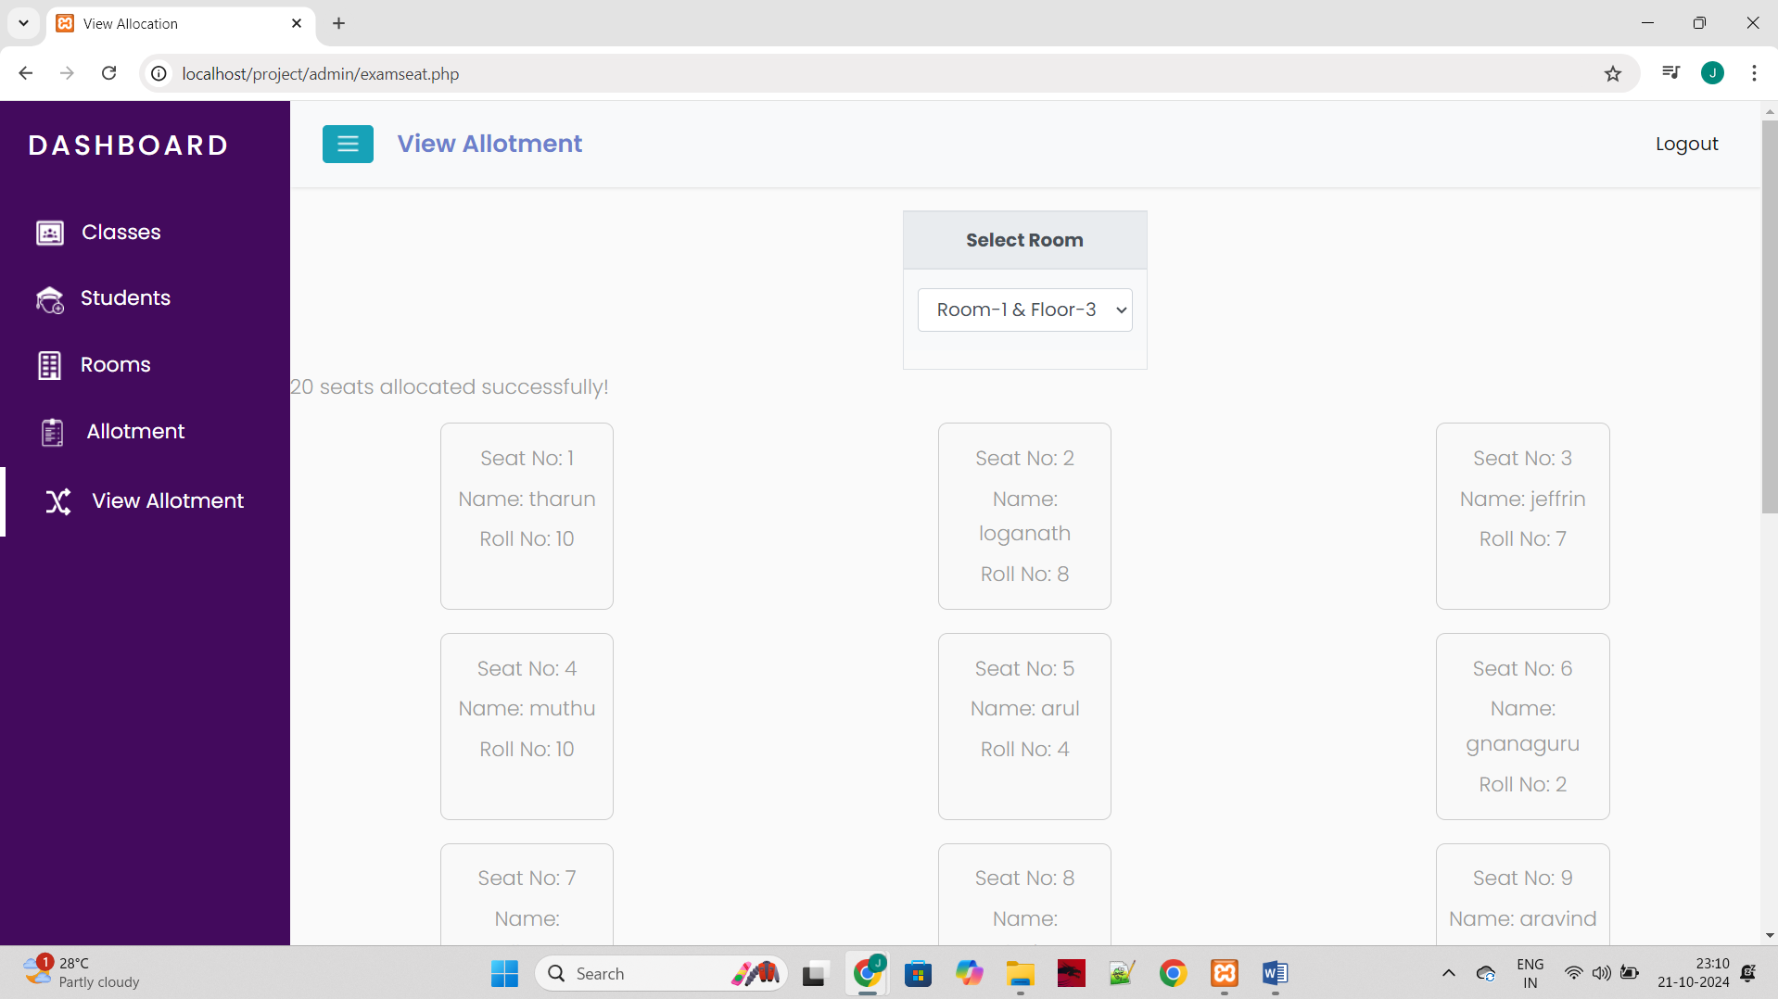
SCREENSHOTS

Slide 11
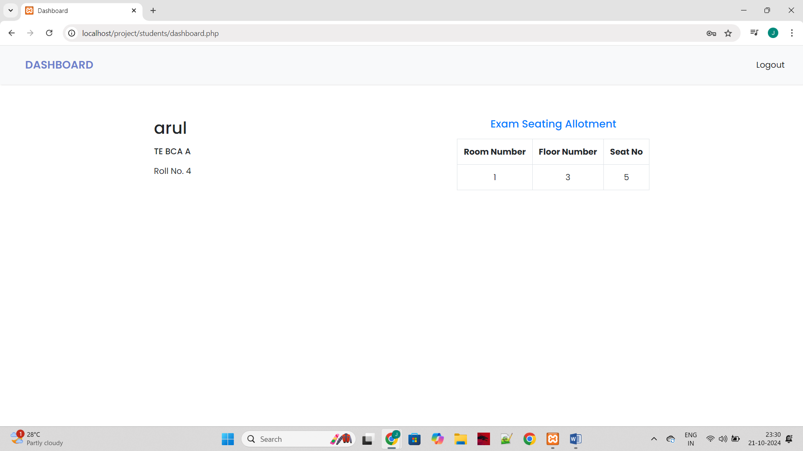
SCREENSHOTS

Slide 12
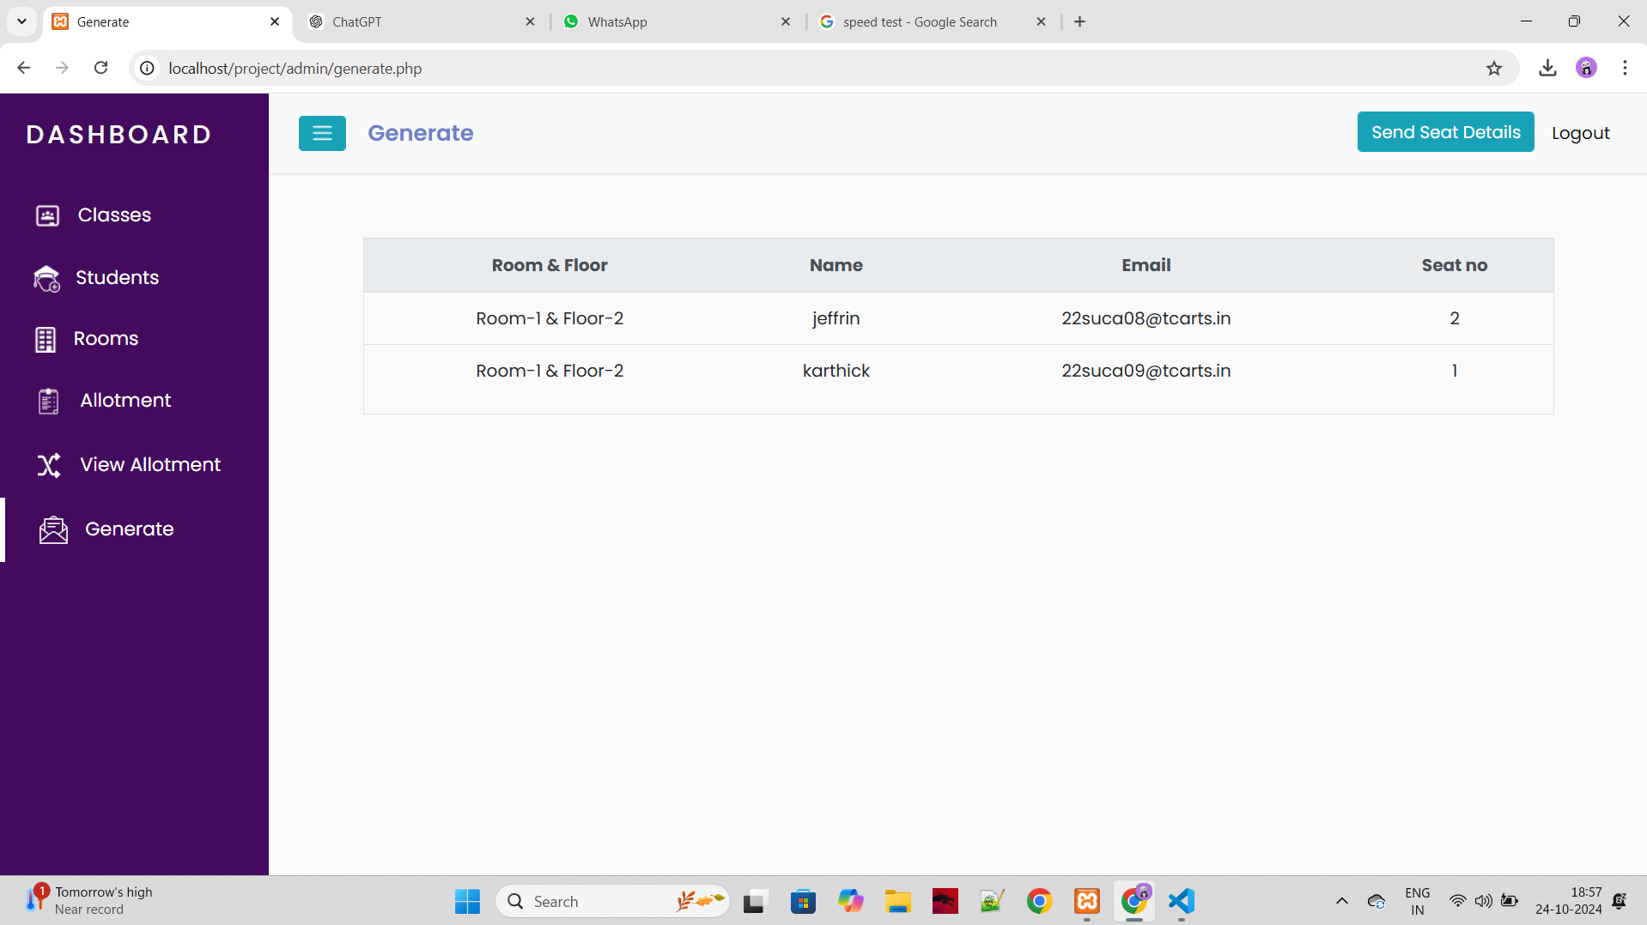
SCREENSHOTS

Slide 13
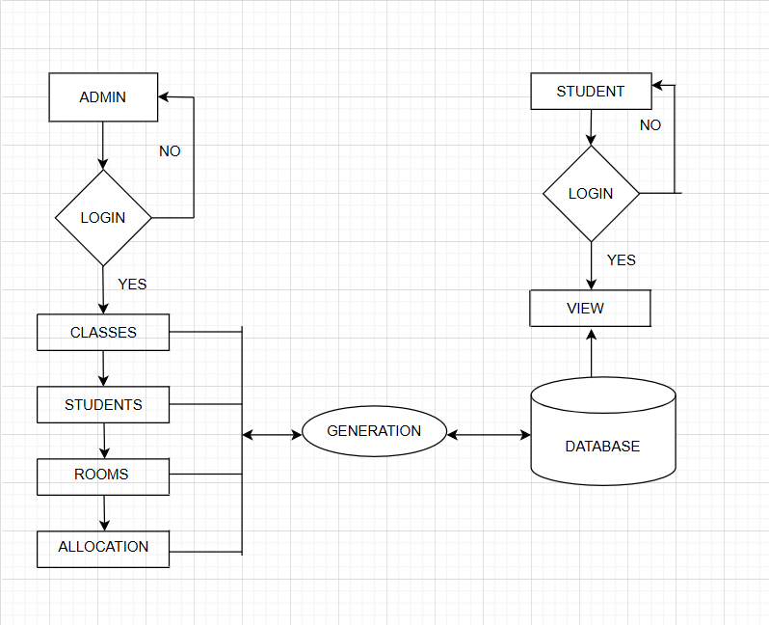
Data Flow Diagram
The data flow diagram illustrates the flow of information and processes within the exam seating arrangement system. It depicts how data is input, processed, and output, providing a visual representation of the system's functionality.

Slide 14
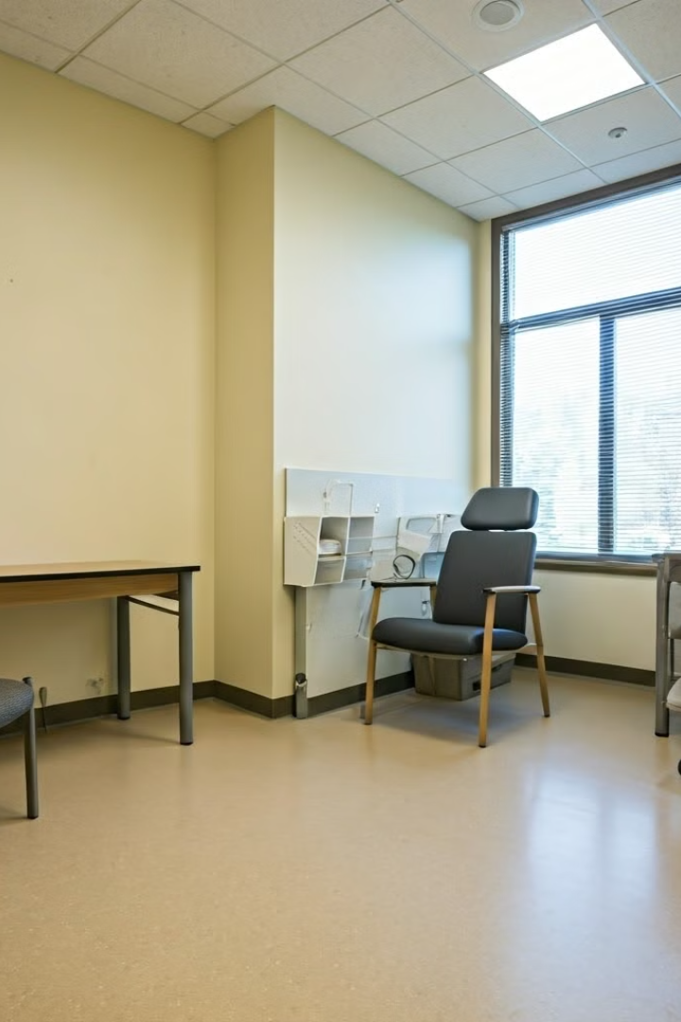
Conclusion
This project offers an efficient and automated solution for managing exam hall seating arrangements, streamlining the process for both administrators and students.
Future Enhancements
Cross-Platform Compatibility: Ensure the web application runs smoothly on multiple operating systems (Windows, macOS, Linux) and devices(Desktops, Tablets).
Integration with other Systems: Enable Integration with other Educational platforms to streamline processes and data sharing.

Slide 15
THANK YOU

